Slide 1
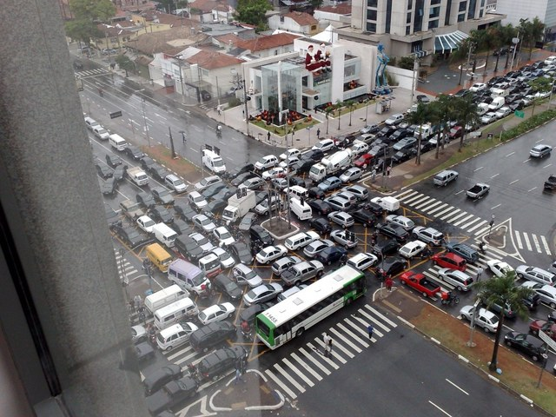
Multiprocessor Synchronization
CSCI 176
Hashing and Natural Parallelism
Lecture 16,17
November 2024
Maurice Herlihy
Brown University

Slide 2
Concurrent List-Based Sets
public interface Set<T> {
public boolean add(T x);
public boolean remove(T x);
public boolean contains(T x);
}
Coarse-grained locking …
Fine-grained locking …
Optimistic …
Lazy!
What more could one ask for?
Faster look-ups!

Slide 3
Sequential Closed Hash Map
0
16
buckets are lists
1
9
2
3
2 Items
h(k) = k mod 4
3
Notes:
3
What’s an extensible hash table? We’re looking at closed addressing table. Here’s the most popular implementation. The table is implemented as an array of buckets, each pointing to a constant size list of elements. Where the number of buckets is a power of two, and the hash function maps an item to the respective bucket of key modulo size.
Seven is inserted to bucket 3,…
As items are added, the total itemcount increases, and when it passes a certain threshold the table is extended.

Slide 4
Add an Item
0
16
1
1
9
2
3
7
3 Items
h(k) = k mod 4
Notes:
4

Slide 5
Add Another: Collision
0
16
4
1
9
2
3
7
4 Items
h(k) = k mod 4
5
Notes:
5

Slide 6
More Collisions
0
16
4
1
9
2
3
7
15
5 Items
h(k) = k mod 4
6
Notes:
6

Slide 7
More Collisions
0
16
4
1
9
2
3
7
15
5 Items
Problem:
buckets becoming too long
h(k) = k mod 4
7
Notes:
7

Slide 8
Resizing
0
16
4
1
9
2
3
7
15
4
5 Items
5
6
h(k) = k mod 4
7
Grow the array
8
Notes:
8
To extend the table one allocates a new bucket array and redistributes the items using the new hash function, which now uses the new size.

Slide 9
Resizing
0
16
4
1
9
Adjust hash function
2
3
7
15
4
5 Items
5
6
h(k) = k mod 8
7
9
Notes:
9
To extend the table one allocates a new bucket array and redistributes the items using the new hash function, which now uses the new size.

Slide 10
Resizing
0
16
4
h(4) = 4 mod 8
1
9
2
3
7
15
4
5
6
h(k) = k mod 8
7
10
Notes:
10
The four must move the bucket four, and 7 and 15 must move to bucket 7.

Slide 11
Resizing
0
16
h(4) = 4 mod 8
1
9
2
3
7
15
4
4
5
6
h(k) = k mod 8
7
11
Notes:
11

Slide 12
Resizing
0
16
h(7) = h(15) = 7 mod 8
1
9
2
3
7
15
4
4
5
6
h(k) = k mod 8
7
12
Notes:
12

Slide 13
Resizing
0
16
h(15) = 7 mod 8
1
9
2
3
4
4
5
6
h(k) = k mod 8
7
7
15
13
Notes:
13

Slide 14
Fields
public class SimpleHashSet {
protected LockFreeList[] table;
public SimpleHashSet(int capacity) {
table = new LockFreeList[capacity];
for (int i = 0; i < capacity; i++)
table[i] = new LockFreeList();
}
…
Array of lock-free lists
14
Notes:
14

Slide 15
Constructor
public class SimpleHashSet {
protected LockFreeList[] table;
public SimpleHashSet(int capacity) {
table = new LockFreeList[capacity];
for (int i = 0; i < capacity; i++)
table[i] = new LockFreeList();
}
…
Initial size
15
Notes:
15

Slide 16
Constructor
public class SimpleHashSet {
protected LockFreeList[] table;
public SimpleHashSet(int capacity) {
table = new LockFreeList[capacity];
for (int i = 0; i < capacity; i++)
table[i] = new LockFreeList();
}
…
Allocate memory
16
Notes:
16

Slide 17
Constructor
public class SimpleHashSet {
protected LockFreeList[] table;
public SimpleHashSet(int capacity) {
table = new LockFreeList[capacity];
for (int i = 0; i < capacity; i++)
table[i] = new LockFreeList();
}
…
Initialization
17
Notes:
17

Slide 18
Add Method
public boolean add(Object key) {
int hash =
key.hashCode() % table.length;
return table[hash].add(key);
}
18
Notes:
18

Slide 19
Add Method
public boolean add(Object key) {
int hash =
key.hashCode() % table.length;
return table[hash].add(key);
}
Use object hash code to pick a bucket
19
Notes:
19

Slide 20
Add Method
public boolean add(Object key) {
int hash =
key.hashCode() % table.length;
return table[hash].add(key);
}
Call bucket’s add() method
20
Notes:
20

Slide 21
No Brainer?
We just saw a
Simple
Lock-free
Concurrent hash-based set implementation
What’s not to like?
We don’t know how to resize …
21
Notes:
21

Slide 22
Is Resizing Necessary?
Constant-time method calls require
Constant-length buckets
Table size proportional to set size
As set grows, must be able to resize
22
Notes:
22

Slide 23
Set Method Mix
Growing is important
Shrinking less so
23
Notes:
23

Slide 24
When to Resize?
Many reasonable policies
Pick a threshold on num of items in a bucket
Global threshold
When ≥ ¼ buckets exceed this value
Bucket threshold
When any bucket exceeds this value
Notes:
24
Java: .75 load factor threshold

Slide 25
Coarse-Grained Locking
Good:
Simple
Hard to mess up
Bad:
Sequential bottleneck
Notes:
25

Slide 26
Fine-grained Locking
0
4
8
1
9
17
2
3
7
11
root
Each lock associated with one bucket
Notes:
26

Slide 27
Resize This
Make sure root reference didn’t change between resize decision and lock acquisition
0
4
8
1
9
17
2
3
7
11
root
Acquire locks in ascending order
Notes:
27

Slide 28
Resize This
0
4
8
0
1
9
17
1
2
2
3
7
11
3
4
5
Allocate new super-sized table
root
6
7
Notes:
28

Slide 29
Resize This
0
4
8
0
8
1
9
17
1
9
17
2
2
3
7
11
3
11
4
4
root
5
6
7
7
Notes:
29
Dashed lines?

Slide 30
Resize This
0
0
8
8
1
1
9
17
9
2
2
3
3
11
11
4
4
4
root
5
6
7
7
Notes:
30

Slide 31
Striped Locks
0
0
8
1
1
9
17
2
2
3
3
11
4
4
root
5
6
7
7
Notes:
31
Seems one lock to sequentialize resizes might be a good idea .. somebody else having the lock already … don’t do anything
Yossi: why not a single lock? If someone have the first lock in the array we block as well…

Slide 32
Observations
We grow the table, but not locks
Resizing lock array is tricky …
We use sequential lists
Not LockFreeList lists
Since we’re locking anyway
Notes:
32
tricky: need to communicate that waiting threads need to recompute the bucket .. with interrupts … disable old locks..

Slide 33
Fine-Grained Hash Set
public class FGHashSet {
protected RangeLock[] lock;
protected List[] table;
public FGHashSet(int capacity) {
table = new List[capacity];
lock = new RangeLock[capacity];
for (int i = 0; i < capacity; i++) {
lock[i] = new RangeLock();
table[i] = new LinkedList();
}} …
Notes:
33

Slide 34
Fine-Grained Hash Set
public class FGHashSet {
protected RangeLock[] lock;
protected List[] table;
public FGHashSet(int capacity) {
table = new List[capacity];
lock = new RangeLock[capacity];
for (int i = 0; i < capacity; i++) {
lock[i] = new RangeLock();
table[i] = new LinkedList();
}} …
Array of locks
Notes:
34

Slide 35
Fine-Grained Hash Set
public class FGHashSet {
protected RangeLock[] lock;
protected List[] table;
public FGHashSet(int capacity) {
table = new List[capacity];
lock = new RangeLock[capacity];
for (int i = 0; i < capacity; i++) {
lock[i] = new RangeLock();
table[i] = new LinkedList();
}} …
Array of buckets
Notes:
35
Protected means only class and subclasses can use it.

Slide 36
Fine-Grained Hash Set
public class FGHashSet {
protected RangeLock[] lock;
protected List[] table;
public FGHashSet(int capacity) {
table = new List[capacity];
lock = new RangeLock[capacity];
for (int i = 0; i < capacity; i++) {
lock[i] = new RangeLock();
table[i] = new LinkedList();
}} …
Initially same number of locks and buckets
Notes:
36

Slide 37
The add() method
public boolean add(Object key) {
int keyHash
= key.hashCode() % lock.length;
synchronized (lock[keyHash]) {
int tabHash = key.hashCode() %
table.length;
return table[tabHash].add(key);
}
}
Notes:
37

Slide 38
Fine-Grained Locking
public boolean add(Object key) {
int keyHash
= key.hashCode() % lock.length;
synchronized (lock[keyHash]) {
int tabHash = key.hashCode() %
table.length;
return table[tabHash].add(key);
}
}
Which lock?
Notes:
38

Slide 39
The add() method
public boolean add(Object key) {
int keyHash
= key.hashCode() % lock.length;
synchronized (lock[keyHash]) {
int tabHash = key.hashCode() %
table.length;
return table[tabHash].add(key);
}
}
Acquire the lock
39
Notes:
39

Slide 40
Fine-Grained Locking
public boolean add(Object key) {
int keyHash
= key.hashCode() % lock.length;
synchronized (lock[keyHash]) {
int tabHash = key.hashCode() %
table.length;
return table[tabHash].add(key);
}
}
Which bucket?
40
Notes:
40

Slide 41
The add() method
public boolean add(Object key) {
int keyHash
= key.hashCode() % lock.length;
synchronized (lock[keyHash]) {
int tabHash = key.hashCode() %
table.length;
return table[tabHash].add(key);
}
}
Call that bucket’s add() method
41
Notes:
41

Slide 42
Resizing
private void resize(int depth,
List[] oldTab) {
synchronized (lock[depth]) {
if (oldTab == table){
int next = depth + 1;
if (next < lock.length)
resize (next, oldTab);
else
sequentialResize();
}}}
42
Notes:
42

Slide 43
Fine-Grained Locking
private void resize(int depth,
List[] oldTab) {
synchronized (lock[depth]) {
if (oldTab == table){
int next = depth + 1;
if (next < lock.length)
resize (next, oldTab);
else
sequentialResize();
}}}
resize() calls resize(0,table)
43
Notes:
43

Slide 44
Resizing
private void resize(int depth,
List[] oldTab) {
synchronized (lock[depth]) {
if (oldTab == table){
int next = depth + 1;
if (next < lock.length)
resize (next, oldTab);
else
sequentialResize();
}}}
Acquire next lock
44
Notes:
44

Slide 45
Resizing
private void resize(int depth,
List[] oldTab) {
synchronized (lock[depth]) {
if (oldTab == table){
int next = depth + 1;
if (next < lock.length)
resize (next, oldTab);
else
sequentialResize();
}}}
Check that no one else has resized
45
Notes:
45

Slide 46
Resizing
private void resize(int depth,
List[] oldTab) {
synchronized (lock[depth]) {
if (oldTab == table){
int next = depth + 1;
if (next < lock.length)
resize (next, oldTab);
else
sequentialResize();
}}}
Recursively acquire next lock
46
Notes:
46

Slide 47
Resizing
private void resize(int depth,
List[] oldTab) {
synchronized (lock[depth]) {
if (oldTab == table){
int next = depth + 1;
if (next < lock.length)
resize (next, oldTab);
else
sequentialResize();
}}}
Locks acquired, get to work
47
Notes:
47

Slide 48
Another Locking Structure
add(), remove(), contains()
  Lock table in shared mode
resize()
  Locks table in exclusive mode

Slide 49
Read-Write Locks
public interface ReadWriteLock {
Lock readLock();
Lock writeLock();
}
Notes:
49

Slide 50
Read/Write Locks
Returns associated read lock
public interface ReadWriteLock {
Lock readLock();
Lock writeLock();
}
Notes:
50

Slide 51
Read/Write Locks
Returns associated read lock
public interface ReadWriteLock {
Lock readLock();
Lock writeLock();
}
Returns associated write lock
Notes:
51

Slide 52
Lock Safety Properties
Read lock:
  Locks out writers
  Allows concurrent readers
Write lock
  Locks out writers
  Locks out readers
Notes:
52

Slide 53
Read/Write Lock
Safety
  If readers > 0 then writer == false
  If writer == true then readers == 0
Liveness?
  Will a continual stream of readers …
  Lock out writers?
Notes:
53

Slide 54
FIFO R/W Lock
As soon as a writer requests a lock
No more readers accepted
Current readers “drain” from lock
Writer gets in
Notes:
54

Slide 55
ByteLock
Readers-Writers lock
Cache-aware
Fast path for privileged slotted readers
Slower path for others

Slide 56
ByteLock Lock Record
Byte for each “slotted” reader
W
0
0
0
0
0
R
Writer id
Single cache line
Count of “unslotted” readers

Slide 57
Writer
Change writer from 0 to i
Writer i
W=0
W
0
0
1
0
1
R=3
CAS
Notes:
A writer first calls CAS to change writer from null to its own ID

Slide 58
Writer
Wait for readers to drain …
Writer i
W=i
0
0
1
0
1
R=3
Notes:
A writer first calls CAS to change writer from null to its own ID

Slide 59

Writer
Proceed when readers gone
(via local spinning)
Writer i
W=i
0
0
0
0
0
R=0
Notes:
A writer first calls CAS to change writer from null to its own ID

Slide 60
Writer
Writer i
Release by resetting writer to 0
W=0
0
0
0
0
0
0
R=0
Notes:
A writer first calls CAS to change writer from null to its own ID

Slide 61
Slotted Reader Fast Path
Slotted Reader
Change my slot from 0 …
W=0
0
0
0
1
0
1
R=3
Notes:
On the fast-path, a slotted reader releases by clearing its byte (also membar)

Slide 62
Slotted Reader Fast Path
Slotted Reader
To 1
W=0
0
1
0
1
0
1
R=3
Notes:
On the fast-path, a slotted reader firs sets its byte

Slide 63
Slotted Reader Fast Path
Slotted Reader
Is there a writer?
W=i
0
1
0
1
0
1
R=3
Notes:
On the fast-path, a slotted reader then confirms no writer

Slide 64
Slotted Reader Fast Path
Slotted Reader
If writer found, reset byte to 0
W=0
0
0
0
1
0
1
R=3
Notes:
On the fast-path, a slotted reader releases by clearing its byte (also membar)

Slide 65
Slotted Reader Fast Path
Slotted Reader
Spin until no writer seen,
then try again
W=i
0
0
0
0
0
1
R=3
Notes:
On the fast-path, a slotted reader then confirms no writer

Slide 66
Slotted Reader Slow Path
Release by setting byte to 0
Slotted Reader
W=i
0
1
0
1
0
1
R=3
Notes:
On the fast-path, a slotted reader firs sets its byte

Slide 67
Slotted Reader Slow Path
Release by setting byte to 0
Slotted Reader
W=i
0
0
0
1
0
1
R=3
Notes:
On the fast-path, a slotted reader firs sets its byte

Slide 68
Unslotted Reader
Unslotted Reader
Increment unslotted readers count
R=4
W=i
0
1
0
0
0
1
R=3
CAS
Notes:
Unslotted reader uses CAS to increment read count

Slide 69
Slotted Reader Slow Path
Slotted Reader
Is there a writer?
W=i
0
1
0
1
0
1
R=3
Notes:
Unslotted reader checks write count … if non-zero …

Slide 70
Unslotted Reader
Unslotted Reader
If writer exists, decrement read counter,
wait for writer to go away, then retry
R=3
W=i
0
1
0
0
0
1
R=3
CAS
Notes:
Use CAS to decrement reader count

Slide 71
The Story So Far
Resizing is the hard part
Fine-grained locks
Striped locks cover a range (not resized)
Read/Write locks
FIFO property tricky
Notes:
71
Yossi: why tricky? (because they don’t know much)

Slide 72
Stop The World Resizing
Resizing stops all concurrent operations
What about an incremental resize?
Must avoid locking the table
A lock-free table + incremental resizing?
Notes:
72

Slide 73
Lock-Free Resizing Problem
0
4
8
1
9
2
3
7
15
Notes:
73
Add 12 to bucket 0 and decide to extend.
Double the table
Try to move 4

Slide 74
Lock-Free Resizing Problem
0
4
4
8
12
12
1
9
Need to extend table
2
3
7
15
4
5
6
7
Notes:
74
Add 12 to bucket 0 and decide to extend.
Double the table
Try to move 4

Slide 75
Lock-Free Resizing Problem
0
4
8
12
1
9
2
3
7
15
4
4
12
5
6
7
Notes:
75
Add 12 to bucket 0 and decide to extend.
Double the table
Try to move 4

Slide 76
Lock-Free Resizing Problem
0
4
8
12
1
9
Need to remove
then add an item:
single-location CAS
not enough
2
3
7
15
4
4
12
5
6
7
We need a new idea…
Notes:
76
Moving items, it doesn’t matter if its one or many, from one bucket to the other, cannot be done efficiently using CAS operations. If you first remove it from the old bucket and only then put it in the new bucket then concurrent threads might not find it. If you first copy it and then remove it from the old bucket that you got a copy management problem, it’s not clear how to manage the inconsistencies.
Building an efficient double-compare-and-swap using primitives existing on today’s machines is also unknown.
So we need a new idea.
Yossi: what copy-management problem? Each thread knows which entries it needs to remove.

Slide 77
Don’t move the items
Move the buckets instead!
Keep all items in a single, lock-free list
Buckets are short-cuts into the list
0
4
2
6
1
5
3
7
0
1
2
3
Notes:
77
Since moving items among buckets is what’s hard, our idea was not to move them. Instead, we will flip the idea of bucket-based hashing on its head. We keep the items fixed and move the buckets. As you can see from the picture, we keep the items in an ordered linked list, which will be implemented using Michael’s technique. Even though all the items are reachable from the top bucket, the additional buckets are shortcuts that allow us to reach items in constant time.

Slide 78
Recursive Split Ordering
0
4
2
6
1
5
3
7
0
Notes:
78
Let’s look at a simple example, Suppose the items 0 through 7 need to be hashed into the table. If we have one bucket, it can only point to the head of the list. Once we have another bucket, we expect it to split the list in 2, and with 4 buckets, each of the two new buckets will recursively split each of those halves, so that in the end, there are only a constant number of items between any two bucket pointers.
In order to allow us to redirect the bucket pointers in this recursive manner, we have to insert the items in such a special order, and order that allows to recursively split buckets.
What is this magical order?

Slide 79
Recursive Split Ordering
1/2
0
4
2
6
1
5
3
7
0
1
Notes:
79

Slide 80
Recursive Split Ordering
1/4
1/2
3/4
0
4
2
6
1
5
3
7
0
1
2
3
List entries sorted in order that allows recursive splitting. How?
Notes:
80

Slide 81
Recursive Split Ordering
0
4
2
6
1
5
3
7
0
0
81
Notes:
81

Slide 82
Recursive Split Ordering
LSB 0
LSB 1
0
4
2
6
1
5
3
7
0
1
LSB = Least significant Bit
82
Notes:
82

Slide 83
Recursive Split Ordering
LSB 00
LSB 10
LSB 01
LSB 11
0
4
2
6
1
5
3
7
0
1
2
3
83
Notes:
83

Slide 84
Split-Order
If the table size is 2^{i},
Bucket b contains keys k
b = k (mod 2^{i})
bucket index consists of key's i LSBs
84
Notes:
84

Slide 85
When Table Splits
Some keys stay
b = k mod(2^{i+1})
Some move
b+2^{i} = k mod(2^{i+1})
Determined by (i+1)^{st} bit
Counting backwards
Key must be accessible from both buckets
Keys that will move must come later
Notes:
85

Slide 86
A Bit of Magic
Real keys:
0
4
2
6
1
5
3
7
Notes:
86
Here are the real keys in the list. And here are their indices in the list. We need to map the real keys to the split-order. How do we do that? Look at the binary representation of the real keys. And look at the binary representations of the desired indices. Magically, but not surprisingly, the map simply needs to reverse the order of the bits. That is, the split-order according to which any two keys should be inserted into the list is given by comparing the binary reversed representations of the keys.

Slide 87
A Bit of Magic
Real keys:
0
4
2
6
1
5
3
7
Real key 1 is in the 4th location
Split-order:
0
1
2
3
4
5
6
7
Notes:
87
Here are the real keys in the list. And here are their indexes in the list. We need to map the real keys to the split-order. How do we do that? Look at the binary representation of the real keys. And look at the binary representations of the desired indexes. Magically, but not surprisingly, the map simply needs to reverse the order of the bits. That is, the split-order according to which any two keys should be inserted into the list is given by comparing the binary reversed representations of the keys.

Slide 88
A Bit of Magic
Real keys:
000
100
010
110
001
101
011
111
Split-order:
000
001
010
011
100
101
110
111
Notes:
88
So if you have, two keys – a and b, a precedes b if and only if the bit-reversed value of a is smaller than the bit-reversed value of b.

Slide 89
A Bit of Magic
Real keys:
000
100
010
110
001
101
011
111
Split-order:
000
001
010
011
100
101
110
111
Just reverse the order of the key bits
Notes:
89
So if you have, two keys – a and b, a precedes b if and only if the bit-reversed value of a is smaller than the bit-reversed value of b.

Slide 90
Split Ordered Hashing
Order according to reversed bits
000
001
010
011
100
101
110
111
0
4
2
6
1
5
3
7
0
1
2
3
Notes:
90

Slide 91
Split Ordered Hashing
parent
000
001
010
011
100
101
110
111
0
4
2
6
1
5
3
7
0
1
child
Notes:
91

Slide 92
Parent Always Provides a Short Cut
0
4
2
6
1
5
3
7
0
search
1
2
3
Notes:
92

Slide 93
Sentinel Nodes
16
4
8
7
15
0
1
2
3
Problem: how to remove a node pointed by 2 sources using CAS
Notes:
93
There are a few other technical details. If you notice, in our implementations have two incoming pointers. This complicated deletions using CAS since we must keep track of how many pointer there are to a given node. To avoid this problem we had logical dummy nodes, one per bucket. That is, as if each bucket points to a dummy and not to a real item in the list and the dummy nodes are never deletes. In reality we need only and additional 4 bytes for the array entries.

Slide 94
Sentinel Nodes
0
16
4
1
9
3
7
15
0
1
2
3
Solution: use a Sentinel node for each bucket
Notes:
94

Slide 95
Sentinel vs Regular Keys
Want sentinel key for i ordered
before all keys that hash to bucket i
after all keys that hash to bucket (i-1)
Notes:
95

Slide 96
Splitting a Bucket
We can now split a bucket
In a lock-free manner
Using two CAS calls ...
One to add the sentinel to the list
The other to point from the bucket to the sentinel
Notes:
96

Slide 97
Initialization of Buckets
0
16
4
1
9
3
7
15
0
1
Notes:
97
When we allocate a new block of buckets they’re uninitialized, and the work of initializing a bucket and redirecting it’s pointer is done incrementally. Buckets are initialized when they are first accessed. This is important in Realtime applications since it means that there is no prolonged resized phase.
explain

Slide 98
Initialization of Buckets
0
16
4
1
9
3
7
15
0
1
2
3
Need to initialize bucket 3 to split bucket 1
Notes:
98
When we allocate a new block of buckets they’re uninitialized, and the work of initializing a bucket and redirecting it’s pointer is done incrementally. Buckets are initialized when they are first accessed. This is important in Realtime applications since it means that there is no prolonged resized phase.
explain

Slide 99
Adding 10
0
16
4
1
9
3
7
15
0
1
2
10
2
hashes to 2
3
Must initialize bucket 2
Notes:
99
When we allocate a new block of buckets they’re uninitialized, and the work of initializing a bucket and redirecting its pointer is done incrementally. Buckets are initialized when they are first accessed. This is important in real-time applications since it means that there is no prolonged resized phase.
explain

Slide 100
Recursive Initialization
To add 7 to the list
7
= 3 mod 4
0
8
12
1
3
= 1 mod 2
0
1
Worst-case log n depth
But expected constant depth
2
Must initialize bucket 1
3
Must initialize bucket 3
Notes:
100
When we allocate a new block of buckets they’re uninitialized, and the work of initializing a bucket and redirecting it’s pointer is done incrementally. Buckets are initialized when they are first accessed. This is important in Realtime applications since it means that there is no prolonged resized phase.
Why do you need to recursively initialize (say 1 before we can initialize 3): When you initialize a bucket you must add it into the list starting in some place, and that place is in the sub-list starting with your parent. If you did not initialize the parents recursively then you would have to look for the parent recursively every time you initialized a bucket and that would anyhow cost you all these lookups. Its cheaper to do the lookup and initialization once.

Slide 101
Lock-Free List
int makeRegularKey(int key) {
return reverse(key | 0x80000000);
}
int makeSentinelKey(int key) {
return reverse(key);
}
Notes:
101

Slide 102
Lock-Free List
int makeRegularKey(int key) {
return reverse(key | 0x80000000);
}
int makeSentinelKey(int key) {
return reverse(key);
}
Regular key: set high-order bit to 1 and reverse
Notes:
102

Slide 103
Lock-Free List
int makeRegularKey(int key) {
return reverse(key | 0x80000000);
}
int makeSentinelKey(int key) {
return reverse(key);
}
Sentinel key: simply reverse (high-order bit is 0)
Notes:
103

Slide 104
Main List
Lock-Free List from earlier lectures
With minor variations
Notes:
104

Slide 105
Lock-Free List
public class LockFreeList {
public boolean add(Object object,
int key) {...}
public boolean remove(int k) {...}
public boolean contains(int k) {...}
public
LockFreeList(LockFreeList parent,
int key) {...};
}
Notes:
105

Slide 106
Lock-Free List
public class LockFreeList {
public boolean add(Object object,
int key) {...}
public boolean remove(int k) {...}
public boolean contains(int k) {...}
public
LockFreeList(LockFreeList parent,
int key) {...};
}
Change: add() takes key argument
Notes:
106

Slide 107
Lock-Free List
public class LockFreeList {
public boolean add(Object object,
int key) {...}
public boolean remove(int k) {...}
public boolean contains(int k) {...}
public
LockFreeList(LockFreeList parent,
int key) {...};
}
Inserts sentinel with key if not already present …
Notes:
107

Slide 108
Lock-Free List
… returns new list starting with sentinel (shares with parent)
public class LockFreeList {
public boolean add(Object object,
int key) {...}
public boolean remove(int k) {...}
public boolean contains(int k) {...}
public
LockFreeList(LockFreeList parent,
int key) {...};
}
Notes:
108

Slide 109
Split-Ordered Set: Fields
public class SOSet {
protected LockFreeList[] table;
protected AtomicInteger tableSize;
protected AtomicInteger setSize;
public SOSet(int capacity) {
table = new LockFreeList[capacity];
table[0] = new LockFreeList();
tableSize = new AtomicInteger(2);
setSize = new AtomicInteger(0);
}
Notes:
109

Slide 110
Fields
public class SOSet {
protected LockFreeList[] table;
protected AtomicInteger tableSize;
protected AtomicInteger setSize;
public SOSet(int capacity) {
table = new LockFreeList[capacity];
table[0] = new LockFreeList();
tableSize = new AtomicInteger(2);
setSize = new AtomicInteger(0);
}
For simplicity treat table as big array …
Notes:
110

Slide 111
Fields
public class SOSet {
protected LockFreeList[] table;
protected AtomicInteger tableSize;
protected AtomicInteger setSize;
public SOSet(int capacity) {
table = new LockFreeList[capacity];
table[0] = new LockFreeList();
tableSize = new AtomicInteger(2);
setSize = new AtomicInteger(0);
}
In practice, want something that grows dynamically
Notes:
111

Slide 112
Fields
public class SOSet {
protected LockFreeList[] table;
protected AtomicInteger tableSize;
protected AtomicInteger setSize;
public SOSet(int capacity) {
table = new LockFreeList[capacity];
table[0] = new LockFreeList();
tableSize = new AtomicInteger(2);
setSize = new AtomicInteger(0);
}
How much of table array are we actually using?
Notes:
112

Slide 113
Fields
public class SOSet {
protected LockFreeList[] table;
protected AtomicInteger tableSize;
protected AtomicInteger setSize;
public SOSet(int capacity) {
table = new LockFreeList[capacity];
table[0] = new LockFreeList();
tableSize = new AtomicInteger(2);
setSize = new AtomicInteger(0);
}
Track set size
so we know when to resize
Notes:
113

Slide 114
Fields
public class SOSet {
protected LockFreeList[] table;
protected AtomicInteger tableSize;
protected AtomicInteger setSize;
public SOSet(int capacity) {
table = new LockFreeList[capacity];
table[0] = new LockFreeList();
tableSize = new AtomicInteger(2);
setSize = new AtomicInteger(0);
}
Initially use single bucket,
and size is zero
Notes:
114

Slide 115
add()
public boolean add(Object object) {
int hash = object.hashCode();
int bucket = hash % tableSize.get();
int key = makeRegularKey(hash);
LockFreeList list
= getBucketList(bucket);
if (!list.add(object, key))
return false;
resizeCheck();
return true;
}
Notes:
115

Slide 116
add()
public boolean add(Object object) {
int hash = object.hashCode();
int bucket = hash % tableSize.get();
int key = makeRegularKey(hash);
LockFreeList list
= getBucketList(bucket);
if (!list.add(object, key))
return false;
resizeCheck();
return true;
}
Pick a bucket
Notes:
116

Slide 117
add()
public boolean add(Object object) {
int hash = object.hashCode();
int bucket = hash % tableSize.get();
int key = makeRegularKey(hash);
LockFreeList list
= getBucketList(bucket);
if (!list.add(object, key))
return false;
resizeCheck();
return true;
}
Non-Sentinel split-ordered key
Notes:
117

Slide 118
add()
public boolean add(Object object) {
int hash = object.hashCode();
int bucket = hash % tableSize.get();
int key = makeRegularKey(hash);
LockFreeList list
= getBucketList(bucket);
if (!list.add(object, key))
return false;
resizeCheck();
return true;
}
Get reference to bucket’s sentinel, initializing if necessary
Notes:
118

Slide 119
add()
public boolean add(Object object) {
int hash = object.hashCode();
int bucket = hash % tableSize.get();
int key = makeRegularKey(hash);
LockFreeList list
= getBucketList(bucket);
if (!list.add(object, key))
return false;
resizeCheck();
return true;
}
Call bucket’s add() method with reversed key
Notes:
119

Slide 120
add()
public boolean add(Object object) {
int hash = object.hashCode();
int bucket = hash % tableSize.get();
int key = makeRegularKey(hash);
LockFreeList list
= getBucketList(bucket);
if (!list.add(object, key))
return false;
resizeCheck();
return true;
}
No change? We’re done.
Notes:
120

Slide 121
add()
public boolean add(Object object) {
int hash = object.hashCode();
int bucket = hash % tableSize.get();
int key = makeRegularKey(hash);
LockFreeList list
= getBucketList(bucket);
if (!list.add(object, key))
return false;
resizeCheck();
return true;
}
Time to resize?
Notes:
121

Slide 122
Resize
Divide set size by total number of buckets
If quotient exceeds threshold
Double tableSize field
Up to fixed limit
Notes:
122

Slide 123
Initialize Buckets
Buckets originally null
If you find one, initialize it
Go to bucket’s parent
Earlier nearby bucket
Recursively initialize if necessary
Constant expected work
Notes:
123
MENTION PARENT PROVIDES SHORT CUT

Slide 124
Recall: Recursive Initialization
To add 7 to the list
7
= 3 mod 4
0
8
12
1
3
= 1 mod 2
0
1
Worst-case log n depth
But expected constant depth
2
Must initialize bucket 1
3
Must initialize bucket 3
Notes:
124
When we allocate a new block of buckets they’re uninitialized, and the work of initializing a bucket and redirecting it’s pointer is done incrementally. Buckets are initialized when they are first accessed. This is important in Realtime applications since it means that there is no prolonged resized phase.
Why do you need to recursively initialize (say 1 before we can initialize 3): When you initialize a bucket you must add it into the list starting in some place, and that place is in the sub-list starting with your parent. If you did not initialize the parents recursively then you would have to look for the parent recursively every time you initialized a bucket and that would anyhow cost you all these lookups. Its cheaper to do the lookup and initialization once.

Slide 125
Initialize Bucket
void initializeBucket(int bucket) {
int parent = getParent(bucket);
if (table[parent] == null)
initializeBucket(parent);
int key = makeSentinelKey(bucket);
LockFreeList list =
new LockFreeList(table[parent],
key);
}
Notes:
125

Slide 126
Initialize Bucket
void initializeBucket(int bucket) {
int parent = getParent(bucket);
if (table[parent] == null)
initializeBucket(parent);
int key = makeSentinelKey(bucket);
LockFreeList list =
new LockFreeList(table[parent],
key);
}
Find parent, recursively initialize if needed
Notes:
126

Slide 127
Initialize Bucket
void initializeBucket(int bucket) {
int parent = getParent(bucket);
if (table[parent] == null)
initializeBucket(parent);
int key = makeSentinelKey(bucket);
LockFreeList list =
new LockFreeList(table[parent],
key);
}
Prepare key for new sentinel
Notes:
127

Slide 128
Initialize Bucket
void initializeBucket(int bucket) {
int parent = getParent(bucket);
if (table[parent] == null)
initializeBucket(parent);
int key = makeSentinelKey(bucket);
LockFreeList list =
new LockFreeList(table[parent],
key);
}
Insert sentinel if not present, and get back reference to rest of list
Notes:
128

Slide 129
Split-Ordered Hash is Linearizable
Theorem
O(1) items expected between two sentinels
Lazy: O(1) expected recursion depth
Can eliminate sentinels
Notes:
129
What we showed is that we implemented a linearizable set and that the expected number items in any bucket is constant. Lazy initialization can happen recursively. You can a chain of up to log n recursive initialization, but that’s the worst case. As we showed, the expected length of such a sequence is constant

Slide 130
Closed (Chained) Hashing
N buckets, M items, Uniform h
Advantages
good performance as density (M/N) increases
less resizing
Disadvantages
Dynamic memory allocation
Poor cache behavior from lack of locality

Slide 131
Open Addressed Hashing
All items in an array
One item for bucket
On collision, find and use nearby empty bucket
Must find items not in own bucket

Slide 132
Linear Probing*
h(x)
z
x
1
2
3
4
5
6
7
8
9
10
11
12
13
14
15
16
17
18
19
20
z
H
=7
contains(x) – search linearly from h(x) to h(x) + H recorded in bucket.
*Attributed to Amdahl…
Notes:
Closed address

Slide 133
Linear Probing
h(x)
z
z
z
z
z
z
z
z
z
x
z
z
z
z
1
2
3
4
5
6
7
8
9
10
11
12
13
14
15
16
17
18
19
20
z
=3
H
=6
add(x) – put in first empty bucket, and update H
Notes:
Closed address

Slide 134

Linear Probing
Expected # items in bucket same as chaining
Expected distance till open slot
$$\frac{1}{2}\left({1+\left(\frac{1}{1−M/N}\right)}^{2} \right)$$
M/N = 0.5 ➔ search 2.5 buckets
M/N = 0.9 ➔ search 50 buckets

Slide 135
Linear Probing
Advantages:
  Good locality ➔ fewer cache misses
Disadvantages:
  As M/N increases more cache misses (searching 10s of unrelated buckets)
  Clustering of keys into neighboring buckets
  Contamination by deleted items ➔ more cache misses

Slide 136
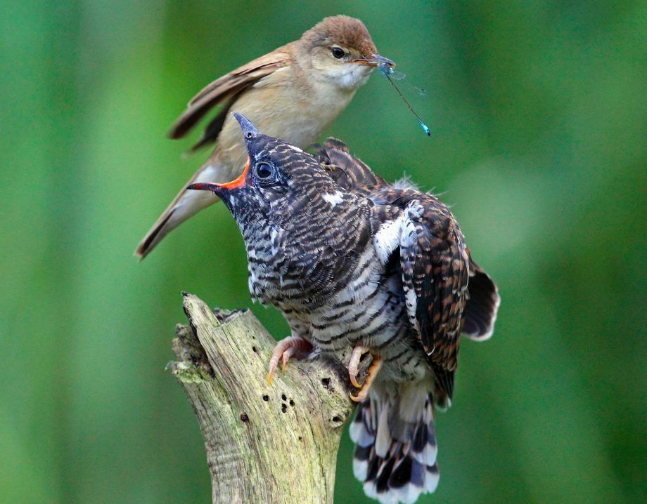
Cuckoo Hashing

Slide 137
Cuckoo Hashing
But cycles
can form
h₁(x)
z
z
z
z
z
y
z
z
z
z
z
z
z
x
1
2
3
4
5
6
7
8
9
10
11
12
13
14
15
16
17
18
19
20
z
z
z
z
z
z
z
w
z
z
z
z
z
1
2
3
4
5
6
7
8
9
10
11
12
13
14
15
16
17
18
19
20
h₂(y)
h₂(x)
add(x) – if h₁(x) and h₂(x) full, evict y and move it to h₂(y) ≠ h₂(x). Then place x in its place.
Notes:
Closed address

Slide 138
Cuckoo Hashing
Advantages:
  contains(x): deterministic 2 buckets
  No clustering or contamination
Disadvantages:
  2 tables
  h_{i}(x) are complex
  As M/N increases ➔ relocation cycles
  Above M/N = 0.5 add() does not work!

Slide 139
Concurrent Cuckoo Hashing
Can lock chain of displacements (see book)
Or have extra space to keep items as they are displaced step by step.

Slide 140
Hopscotch Hashing
Single Array, Simple hash function
Idea: define neighborhood of original bucket
In neighborhood items found quickly
Use sequences of displacements to move items into their neighborhood

Slide 141
Hopscotch Hashing
h(x)
z
x
1
2
3
4
5
6
7
8
9
10
11
12
13
14
15
16
17
18
19
20
1
0
1
0
H=4
contains(x) – search in at most H buckets
(the hop-range) based on hop-info bitmap.
In practice pick H to be 32.
Notes:
The material on Hopscotch hashing is not in the textbook and appears at http://mcg.cs.tau.ac.il/projects/hopscotch-hashing-1/

Slide 142
Hopscotch Hashing
h(x)
u
w
v
z
x
r
s
1
2
3
4
5
6
7
8
9
10
11
12
13
14
15
16
17
18
19
20
1
1
0
1
1
0
1
1
0
0
1
0
0
0
1
1
add(x) – probe linearly to find open slot.
Move the empty slot via sequence of
displacements into the hop-range of h(x).
Notes:
Closed address

Slide 143
Hopscotch Hashing
contains
  wait-free, just look in neighborhood
add
  Expected distance same as in linear probing
resize
  neighborhood full less likely as H → log n
  one word hop-info bitmap, or use smaller H and default to linear probing of bucket
Notes:
Lemma 5. The probability of probing for an empty slot, with length bigger then
H is ®H¡1.

Slide 144
Advantages
Good locality and cache behavior
As table density (M/N) increases → less resizing
Move cost to add() from contains(x)
Easy to parallelize

Slide 145
Recall: Concurrent Chained Hashing
1
2
3
4
5
6
7
8
9
10
11
12
13
14
15
16
17
18
19
20
Lock for add()
and unsuccessful
contains()
Striped Locks
Notes:
Closed address

Slide 146
Concurrent Simple Hopscotch
h(x)
1
2
3
4
5
6
7
8
9
10
11
12
13
14
15
16
17
18
19
20
contains() is wait-free
Notes:
Closed address

Slide 147
Concurrent Simple Hopscotch
u
z
v
r
x
1
2
3
4
5
6
7
8
9
10
11
12
13
14
15
16
17
18
19
20
1
0
0
1
ts
add(x) – lock bucket, mark empty slot using CAS, add x erasing mark
Notes:
Closed address

Slide 148
Concurrent Simple Hopscotch
u
z
v
r
s
s
1
2
3
4
5
6
7
8
9
10
11
12
13
14
15
16
17
18
19
20
1
0
0
1
ts
1
0
0
0
1
0
0
0
1
1
1
0
1
0
1
1
ts+1
ts
ts
add(x) – lock bucket, mark empty slot using CAS, lock bucket and update timestamp of bucket being displaced before erasing old value
Notes:
There are many entries that could potentially have the given entry in their hop-
information, but, as we prove, there can only be one that actually has it at any
given point. To add() or remove() an item, only one lock, the lock of the location
with the hop information is acquired. Then, to move an item, while the lock is
held, the full-empty bit of the empty location is set, and then a key and its data
are moved. No thread ever spins on this full-empty information, so it cannot be
a source of deadlock. Since only one lock is ever taken at a time, there cannot be
deadlock. The algorithm is however not starvation-free: it trusts the natural distri-
bution of hashed values to prevent starvation, and if this distribution is unfair, one
can replace the simple locks we use with more expensive fair locks.

Slide 149
Concurrent Simple Hopscotch
x not found
u
z
v
s
r
1
2
3
4
5
6
7
8
9
10
11
12
13
14
15
16
17
18
19
20
1
0
0
1
ts
Contains(x) – traverse using bitmap and if ts has not changed after traversal item not found. If ts changed, after a few tries traverse through all items.
Notes:
Closed address

Slide 150
Is performance dominated by cache behavior?
Parallel and sequential benchmarks
With and without memory pre-allocation

Slide 151
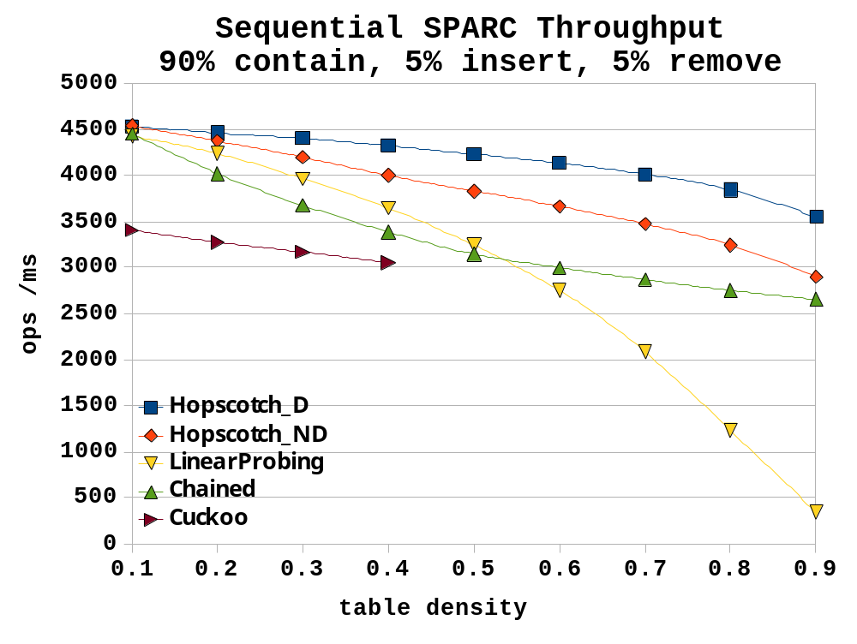
with memory pre-allocated

Slide 152
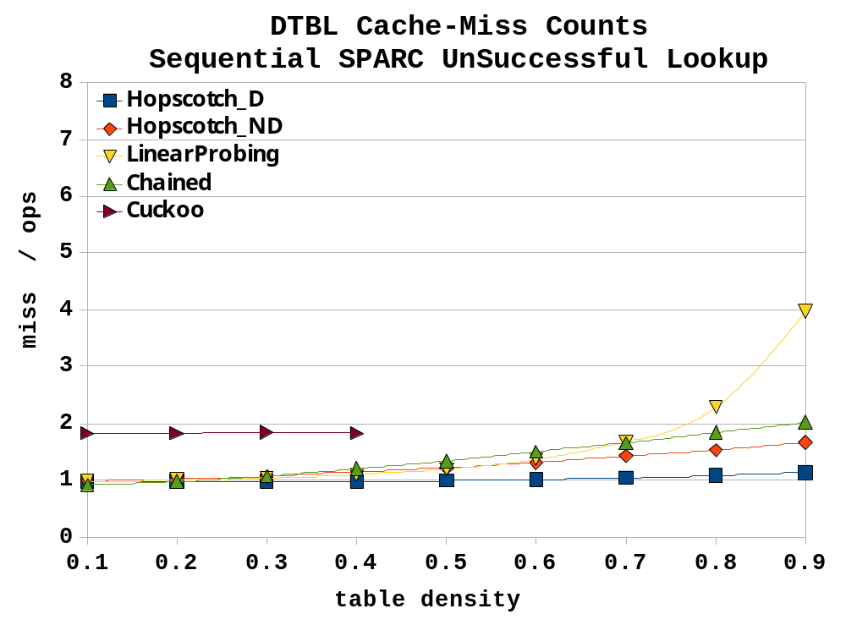

Slide 153
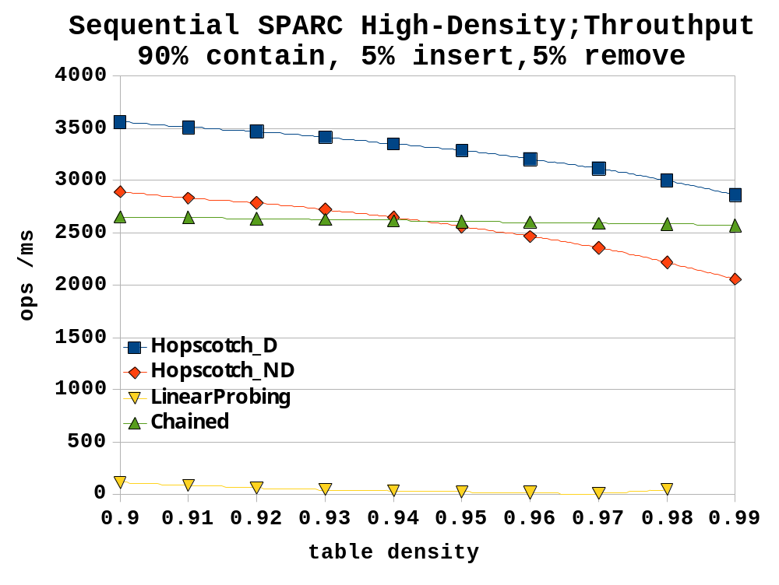

Slide 154
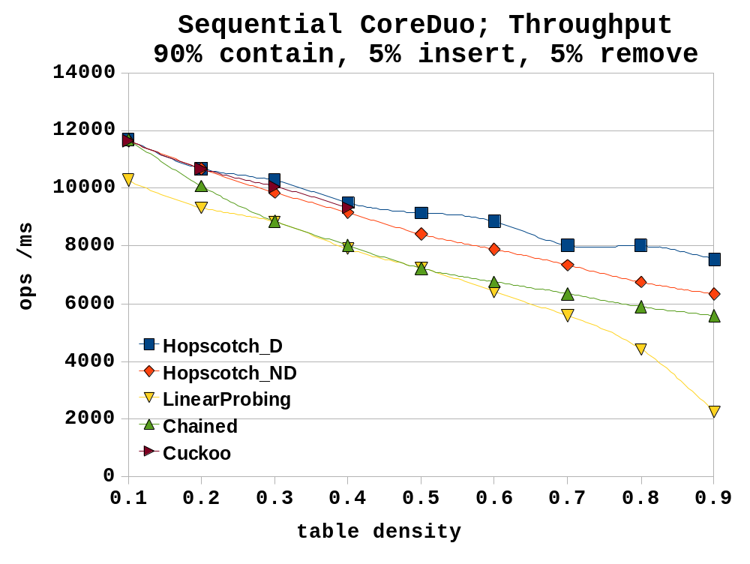
Cuckoo stops here

Slide 155
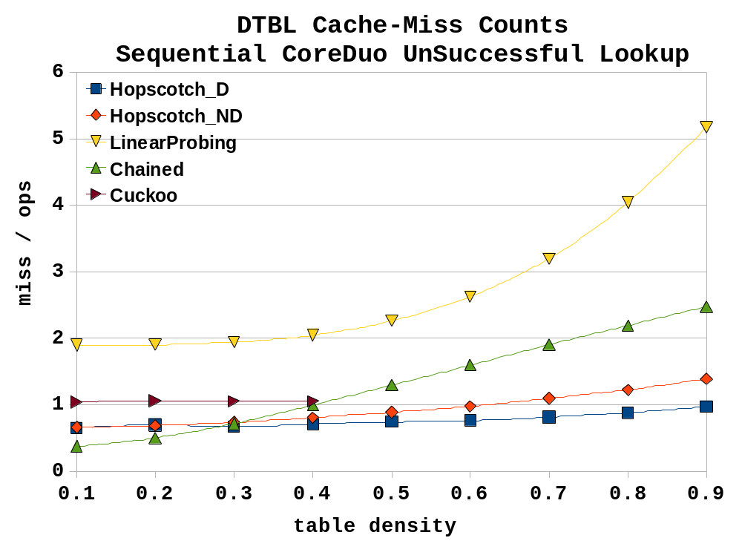

Slide 156
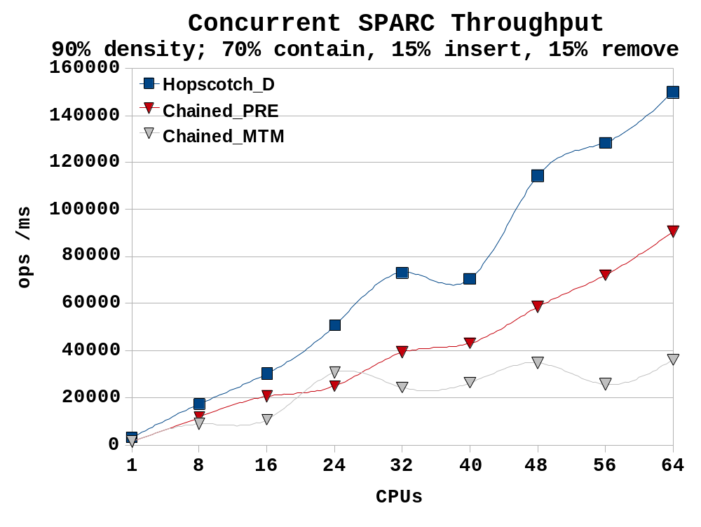
with memory pre-allocated
with allocation

Slide 157
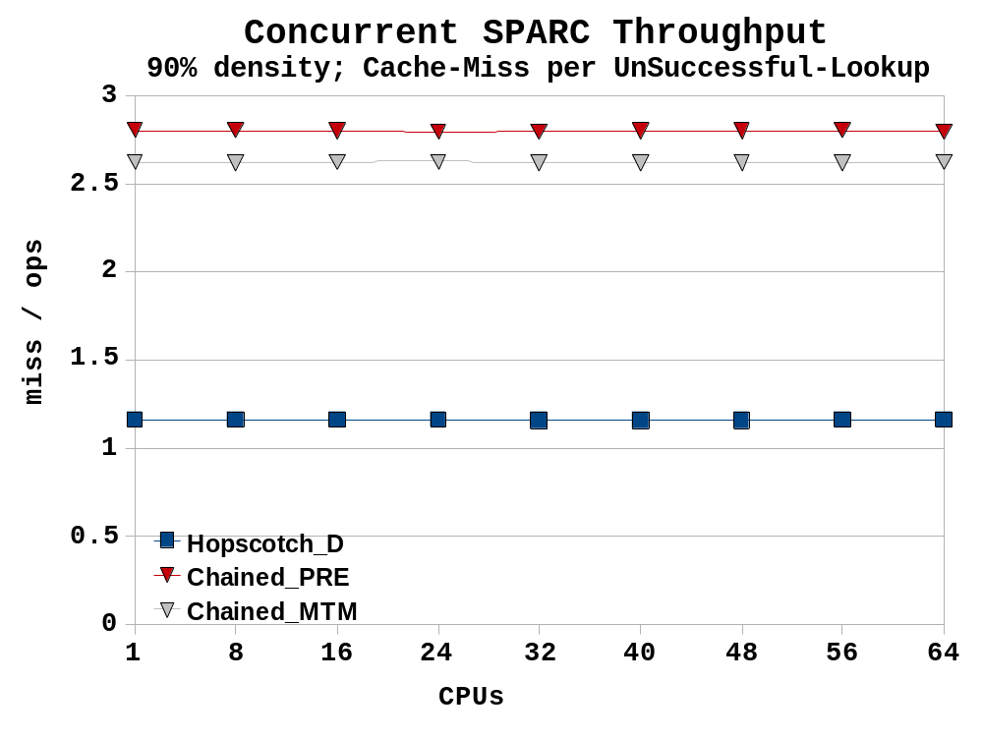

Slide 158
Summary
Chained Hash / striped locks
Simple and effective in many cases
Hopscotch / striped locks
Good cache behavior
Split-ordered
Good for incremental resizing

Slide 159

Closed (list-based) hash maps
Resizing
Lock striping
Read-Write locks (ByteLock)
Lock-free (split-order) resizing
Open (array-based) hash maps
Hopscotch hashing
159
Notes:
159
In the worst case one can prove that n concurrent stack accesses must take omega(n) time if one takes into account the stalls caused when one thread waits for another to complete its stack access.

Slide 160
This work is licensed under a Creative Commons Attribution-ShareAlike 2.5 License.
You are free:
  to Share — to copy, distribute and transmit the work
  to Remix — to adapt the work
Under the following conditions:
  Attribution. You must attribute the work to “The Art of Multiprocessor Programming” (but not in any way that suggests that the authors endorse you or your use of the work).
  Share Alike. If you alter, transform, or build upon this work, you may distribute the resulting work only under the same, similar or a compatible license.
For any reuse or distribution, you must make clear to others the license terms of this work. The best way to do this is with a link to
  http://creativecommons.org/licenses/by-sa/3.0/.
Any of the above conditions can be waived if you get permission from the copyright holder.
Nothing in this license impairs or restricts the author's moral rights.
160
Notes:
160

Slide 161
Good locality and cache behavior
As table density (M/N) increases → less resizing
Move cost to add()from contains(x)
Easy to parallelize

Slide 162
Advantages:
  Good locality ➔ fewer cache misses
Disadvantages:
  As M/N increases more cache misses
    searching 10s of unrelated buckets
    “Clustering” of keys into neighboring buckets
  As computation proceeds “Contamination” by deleted items ➔ more cache misses
M/N = 0.5 ➔ search 2.5 buckets
M/N = 0.9 ➔ search 50 buckets
Must find items not in own bucket
Dynamic memory allocation
Poor cache behavior from lack of locality
which properties are important
Keys that will move must come later

